Slide 1

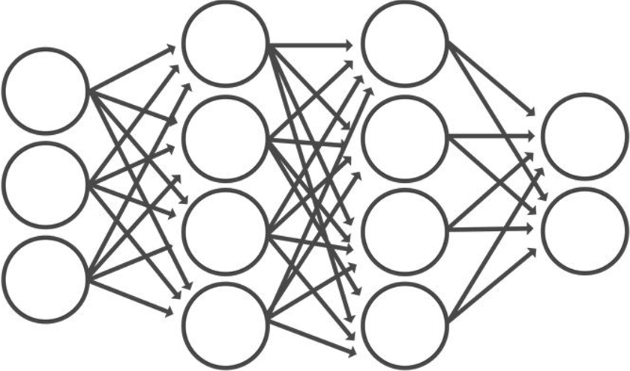
[0]
[1]
[2]
[3]
[4]
Data
CNN Model
Class
Notes:
CNN Model

Slide 2
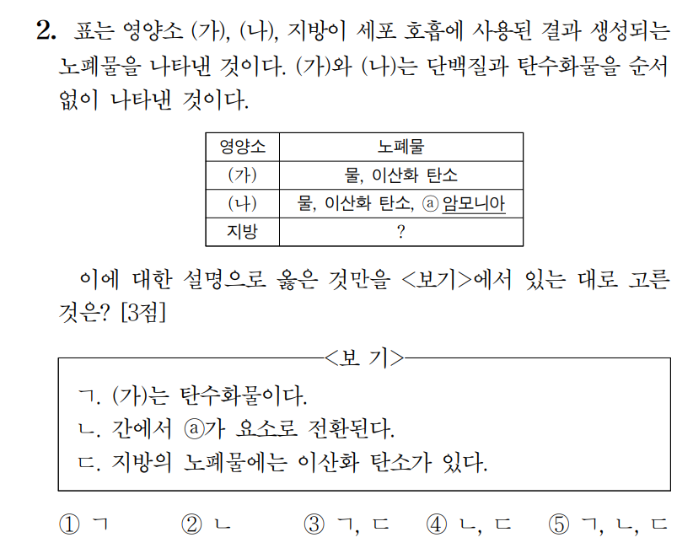
2nd Question for Biology 1 of The Korean CSAT 2022
Text
Class
[0]
[1]
[2]
[3]
[4]
Notes:
2nd Question for Biology 1 of The Korean CSAT 2022

